Slide 1
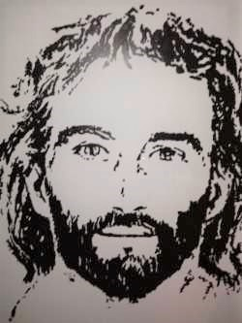
JESUS, JESUS, JESUS:
BE HEALED
IN THE NAME OF JESUS
Texas Spiritual Encounter Weekend
April 6-8, 2018
Camp Sionito, Bandera, TX

Slide 2
Friday Night Praise Music and Introduction
We Believe:
https://www.youtube.com/watch?v=T5CVN-dpvbQ
There’s Just Something About That Name:
https://www.youtube.com/watch?v=2AOD-7YZDO4
Mercy Me – Flawless:
https://www.youtube.com/watch?v=HZ7EyPTOltw
Steve Harvey – Introduction To Jesus Christ:
https://www.google.com/search?q=steve+harvey+introduction+to+jesus&rlz=1C1CHZL_enUS685US687&oq=steve+harvey+introduction+&aqs=chrome.2.69i57j0l5.14893j0j4&sourceid=chrome&ie=UTF-8

Slide 3
Getting To Know
One Another

Slide 4
JESUS, JESUS, JESUS:
BE HEALED IN THE NAME OF JESUS
SPIRITUAL HEALING
KNOWLEDGE OF THE WORD
EMOTIONAL HEALING
RELATIONSHIPS
FORGIVENESS
PHYSICAL HEALING
HEALING

Slide 5
Our Expectations For The Group
Closer Intimate Relationship With God, Jesus, And The Holy Spirit. (I Cor. 3:10-11)
2. Revelation That Jesus Is The Healer.
3. Personal Encounter With The Holy Spirit.
4. Understanding God’s Will For Healing.
Expect And Receive A Miracle.
Know That All Things Are Possible.
Get Real And Surrender.

Slide 6
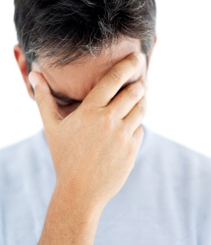
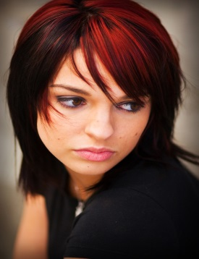
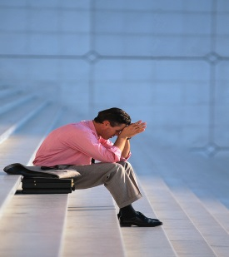
“Get Real And Surrender”
Problem:
I Can Be Really A Self-centered Person
When Not Looking To Jesus, I Focus On Worldly Things
I Have An Attitude
Not Good At Surrendering
Not Easy Forgiving Myself
Profane The Name And The Work Of The Lord
Dishonor God Daily
Struggle Like I Am In A Hopeless Battle
I Am Addicted To Sin
Poor Representative Of The Lord’s Character
I Am Rebellious
I Have Idols
All The Self Things Seem To Overwhelm Me At Times
Focused On I, Me, Mine
It Is About My Ego
Old Ways Are A Stumbling Block For Me
Not Ready To Change

Slide 7
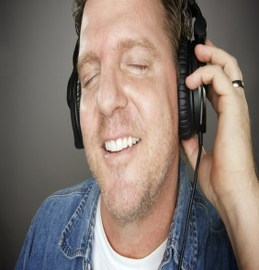
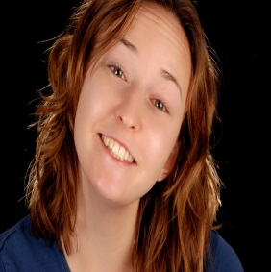
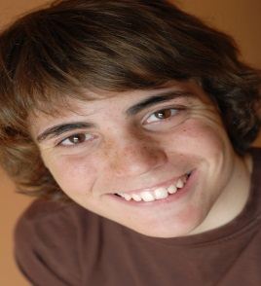
“Get Real And Surrender” (Cont’d)
Solution:
Understand And Be Convicted About Christ’s Birth, Crucifixion, And Resurrection
Go Through A Purging Process (Self-will, Selfishness, Self-esteem, And Anything That Causes Me To Think About Myself First And God Second)
Die To Self
Be More Like Jesus Christ
Walk Uprightly Before The Lord And Obey His Rules And Commandments
Receive A New Heart
Learn To Live By The Spirit And Not Walk In The Flesh
God’s Grace In My Life Now
Learn Humility, Exercise My Faith, See And Do Deeds Of Action
Seek Wisdom, Revelation, Knowledge, Mercy, Grace, Breakthrough, And Favor
Spend Personal Time With God, Jesus, And The Holy Spirit
Keep My Focus On Jesus And What He Did On The Cross

Slide 8
Healing Testimony of Krystal
Video
Start at 2:55 Mins.
Stop at 6:32 Mins.
https://www.youtube.com/watch?v=tO4oH1unVVI

Slide 9

“Get Real And Surrender” (Cont’d)
Write Your Needs Down On Prayer Charts:
Physical Needs
Emotional Needs
Spiritual Needs
Financial Needs
Relationship Needs

Slide 10
“All Things Are Possible”
Mark 9:16-29
https://www.youtube.com/watch?v=x_NcescDvdQ

Slide 11
Saturday Morning Praise Music
Your Great Name:
https://www.youtube.com/watch?v=3zpLPh6LibE
10,000 Reasons:
https://www.youtube.com/watch?v=DXDGE_lRI0E
What A Beautiful Name:
https://www.youtube.com/watch?v=r5L6QlAH3L4

Slide 12
That’s My King
S.M. Lockridge https://www.youtube.com/watch?v=yzqTFNfeDnE
Rom. 1:16-17
“I am not ashamed of the Gospel, because it is the power of God for the salvation of everyone who believes; first for the Jew, and then for the Gentile.”

Slide 13
God’s Will For Healing
SPIRITUAL – EMOTIONAL – PHYSICAL
“Laying The Foundation”
(I Cor. 3:10-11)

Slide 14
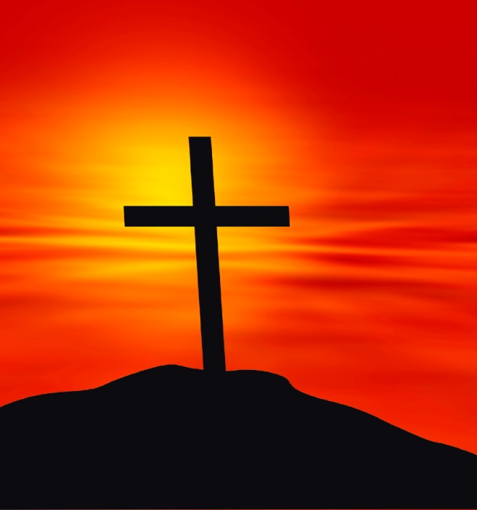
God’s Will For Healing
Answer: “Study The Scriptures And You Will Find It.”
Summary:
Healing Is God’s Will According To The Scriptures.
The Method Of Healing And The Timing Is God’s Choice.
Jesus Purchased Our Healing On The Cross For Our Iniquities, Transgressions, Sicknesses, And Diseases. And With His Stripes We Are Healed. (Isa. 53:4-5; Matt. 8:16-17)
You Are His Child, He Created You, Loves You, Has Compassion For You.
He Has A Covenant Relationship With You And Is Responsible For Doing What Is In Our Best Interest. God Wants You Well And Whole.

Slide 15
Christian Healing
Troy Black Video
https://www.youtube.com/watch?v=qHQYYnXgC4I

Slide 16
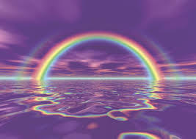
Demonstrations of Healing
God
Holy Spirit
Jesus Christ
Apostles
Disciples

Slide 17
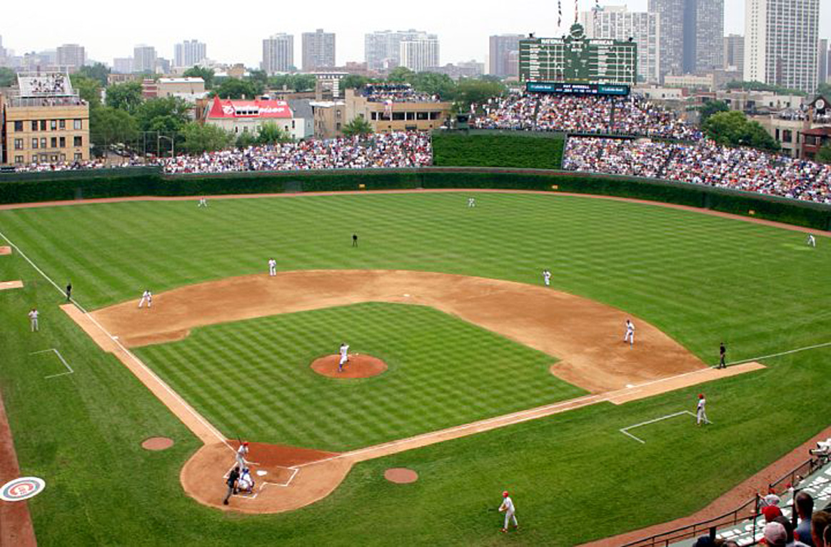
He Commanded The People In The Old Testament: (Conditional)
Believe In Me (Accept/Believe/Confess)
Be Faithful (Exercise The Measure Of
Faith Dealt To You)
3. Trust (Trust In Me For All Things)
4. Be Obedient (Obey Me And Keep My Commandments)
5. Come To Me With A Repentant Spirit (Surrender Self)
6. Put God First (Keep Your Focus On God)

Slide 18
What God Requires
He Requires Belief And Faith
“This Day I Called The Heavens And The Earth As Witnesses Against You That I Have Set Before You Life And Death, Blessings And Curses. Now Choose Life, So That You And Your Children May Live, And That You May Love The Lord Your God, Listen To His Voice, And Hold Fast To Him.”
(Deut. 30:19-20)
He Requires Trust
“Trust In The Lord With All Your Heart And Lean Not On Your Own Understanding; In All Your Ways Submit To Him, And He Will Make Your Path Straight.”
(Proverbs 3:5-6)

Slide 19
What God Requires (Cont’d)
He Requires Obedience
“If You Listen Carefully To The Voice Of The Lord Your God And Do What Is Right In His Eyes, If You Pay Attention To His Commands And Keep All His Decrees, I Will Not Bring On You Any Of The Diseases I Brought On The Egyptians, For I Am The Lord, Who Heals You.”
(Ex. 15:26)
He Requires Repentance
“If My People, Who Are Called By My Name, Will Humble Themselves And Pray And Seek My Face And Turn From Their Wicked Ways, Then I Will Hear From Heaven And Will Forgive Their Sin And Will Heal Their Land. Now My Eyes Will Be Open And My Ears Attentive To The Prayers Offered In This Place.”
(2 Chron. 7:14)

Slide 20
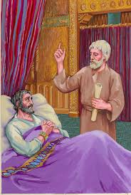
What God Requires (Cont’d)
  He Requires We Put God First
“In Those Days Hezekiah Became Ill And Was At The Point Of Death. The Prophet Isaiah Son Of Amoz Went To Him And Said: This Is What The Lord Says: Put Your House In Order, Because You Are Going To Die; You Will Not Recover.” Hezekiah Turned His Face To The Wall And Prayed To The Lord, “Remember Me O Lord, How I Have Walked Before You Faithfully And With Wholehearted Devotion And Have Done What Is Good In Your Eyes.” And Hezekiah Wept Bitterly.”
God Told Isaiah To Go Back To Hezekiah And Tell Him. “I Have Heard Your Prayers And Seen Your Tears. I Will Heal You. On The Third Day Go Up To The Temple Of The Lord. I Will Add Fifteen Years To Your Life. Then Isaiah Said, “Prepare A Poultice Of Figs.” They Did So And Applied It To The Boil, And He Recovered.” (2 Kings 20:1-7)

Slide 21
12 Demonstrations Of Healings
In The Old Testament
1. King Abimelech (A Lie)
(Gen. 20:1-18)
2. Miriam (Leprosy)
(Num. 12:1-15)
3. Hannah (Barren/Samuel)
  (1 Sam. 1:9-20)
King Jeroboam (Shriveled
Hand) (1 Kings 13:4-6)
Elijah (Raised Dead Boy)
(1 Kings 17:17-24)
6. Shunammite Woman
(Barren)(2 Kings 4:8-17)
7. Naaman (Leprosy)
(2 Kings 5:1-14)
8. Job (Healed/Restored)
(Job 42:10-17)
9. Nebuchadnezzar
(Insanity)(Dan. 4:34,36)
10. Woman’s Son (Born and
Raised From Death)
(2 Kings 4:18-37)

Slide 22
12 Demonstrations Of Healings
In The Old Testament (Cont’d)
11. Dead Man Resurrected
(From Elisha’s Body)
(2 Kings 13:21)
12. King Hezekiah (Boil-
Terminal)
(2 Kings 20:1-7)
Corporate Healings:
Aaron/Plague
(Num. 16:46-50)
Moses/Venomous Snakes
(Num. 21:4-9)
David Plague
(2 Sam. 24:10-25)

Slide 23

Holy Spirit And Healing
All Healings Are The Demonstration Of The Power And Authority Of The Holy Spirit – He Is The Doer.
Role Of The Holy Spirit Is Administrator Of The Gifts.
Holy Spirit’s Gifts And Direction. (I Cor. 12: 4-11)

Slide 24
Holy Spirit And Healing (Cont’d)
Power And Authority Of Holy Spirit Came To The Apostles And Disciples. (Acts 1:4-5) (Acts 2:1-4)
  Jesus Said, “Do Not Leave Jerusalem But Wait For The Gift My Father Promised, For Which You Have Heard Me Speak About. For John Baptized With Water, But In A Few Days You Will Be Baptized With The Holy Spirit.”
Holy Spirit Gives Us Power And Authority To Rebuke The Illness. (Matt. 10:1,8) (Mark 16:17-21) (Luke 9:1-4)

Slide 25
Troy Black Testimony - Healing
Video
https://www.youtube.com/watch?v=hfMbWuKDLuA

Slide 26
Jesus, Jesus, Jesus
Why Did Jesus Heal?
To Fulfill Prophecy and Prove He Was The Messiah.
To Demonstrate His Power To Forgive Sin.
To Display The Works Of God With Miracles and Healings.
To Give A Demonstration Of God’s Healing Power And Authority.
To Give Glory To God.
To Bring People To Faith.
To Show Compassion For His People .

Slide 27
Factors Involved In Healing
Disciples Prayed With The Power and Authority Of The Holy Spirit.
Healed Everyone Who Came To Him – His Will And Desire, His Compassion.
Faith Is Essential In Healing. (Romans 12:3 - Dealt The Measure Of Faith)
Requires Action With Your Faith.
Dealing With Evil Spirits. (Woman Bent Over 18 Yrs.)
Laying On Of Hands.
Not Everyone Was Instantly Healed. (10 Lepers, Blind Man)
  8. Asked Questions Of People.
  9. Requires Prayer And Fasting.
  10. Confirm The Healing.
  11. No Strict Formula For Healing.
  12. Not Limited By Distance Or
  Clothing.
  13. Right Environment Without
  Doubt And Unbelief.
  14. Expect To Be Challenged
  And Ridiculed.
  15. In The Name Of Jesus.

Slide 28
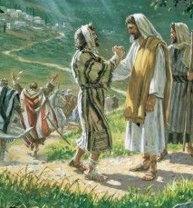
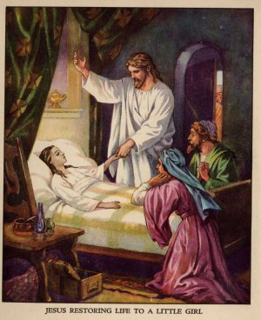
Demonstrations Of
Healing By Jesus
Leper - Matt. 8:1-4, Mark 1:40-42, Luke 5:12-13
Roman Centurion’s Servant - Matt. 8:5-13, Luke 7:1-10
Peter’s Mother-in-Law –Matt. 8:14-15, Mark 1:29-31, Luke 4:38-39
Wild Men Of Gadara – Matt. 8:28-34, Mark 5:1-15,
Luke 8:26-35
Crippled Paralytic - Matt. 9:1-7, Mark 2:1-12, Luke 5:18-25
Man With Unclean Spirits - Mark 1:23-26, Luke 4:33-35
Boy With Seizures – Matt. 17:14-18, Mark 9:14-29, Luke 9:37-43
This Photo by Unknown Author is licensed under CC BY-NC

Slide 29
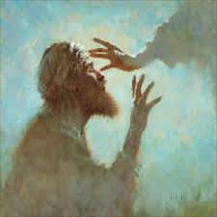
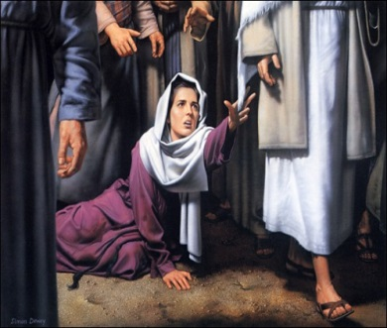
Demonstrations Of
Healing By Jesus (Cont’d)
Blind Bartimaeus - Mark 10:46-52, Luke 18:35-43
Demon Posses Man – Matt. 8:32-33
Man With A Shriveled Hand – Matt. 12:10-13, Mark 3:1-5, Luke 6:6-10
Syrophoenician’s Daughter – Matt. 15:21-28, Mark 7:24-30
Woman With A Hemorrhage – Matt. 9:20-22, Mark 5:25-29, Luke 8:43-48
Man With Dropsy - Luke 14:1-4
Ten Lepers - Luke 17:11-19
Malchus’ Ear - Luke 22:50-51, John 18:3-11

Slide 30
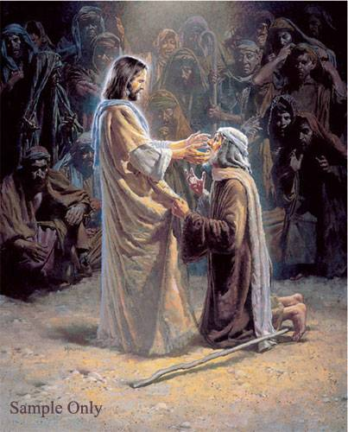
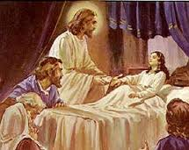
Demonstrations Of
Healing By Jesus (Cont’d)
Deaf, Speechless Man – Mark 7:31-37
Blind Man At Bethsaida - Mark 8:22-26
Infirmity In The Woman - Luke 13:11-13
Official’s Son - John 4:46-54
Two Blind Men – Matt. 9:27-31, Matt. 20:30-34
Raising Of Jairus’ Daughter – Matt. 9:23-25, Mark 5:22-42, Luke 8:41-56
Lame Man At Bethsaida - John 5:1-9
Raising Of Lazarus - John 11:38-44
Raising Of The Widow’s Son - Luke 7:11-15

Slide 31
You Are Looking At A Miracle:
Video
Dead For 45 Mins.
https://www.youtube.com/watch?v=Bmyx9qJkeQQ

Slide 32
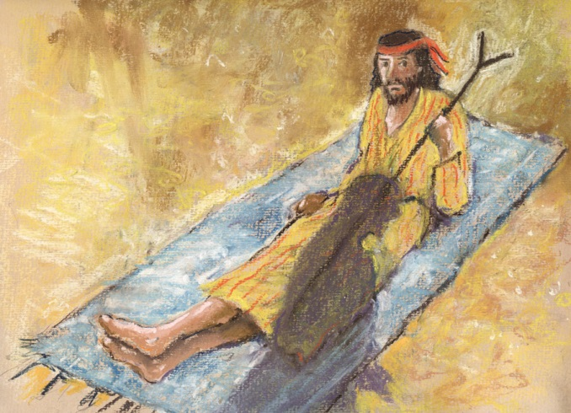
Demonstrations Of Healing By Apostles
Lame Man At Temple Gate - Acts 3:1-9
Apostles’ Signs And Wonders - Acts 2:43
Faith To Be Healed -
Acts 5:12-16
Healed A Paralytic Named Aeneas - Acts 9:32-35
Healed Tabitha - Acts 9:36-43
Crippled Man From Lystra - Acts 14:8-11
Resurrection Of Eutychus - Acts 20:9-12
Publius Father Healed Of Fever And Bleeding - Acts 28:7-9
Philip In Samaria - Acts 8:6

Slide 33
Power And Authority
To Heal As Christ’s Disciples
Where Does The Power And Authority Come From? “And Jesus Came And Spake Unto Them, Saying, All Power Is Given Unto Me In Heaven And In Earth.” (Matt. 28:18; John 5:19,30; John 8:28; John 7:16-18)
Jesus Gave The Power And Authority To The Disciples Through The Holy Spirit. They Had To Wait For The Holy Spirit To Come Upon Them. (Acts 2: 1-4; Matt 10:1; Luke 10:19; Matt. 10:8)
As Believers Of Jesus Christ We Are Authorized Representatives Of God With All Of The Power And Authority To Carry Out His Instructions And Directions. (Mark 16:15-18)

Slide 34
Power And Authority To Heal As Christ’s Disciples (Cont’d)
Matt 10:1 “He Called His Twelve Disciples To Him And Gave Them Authority To Drive Out Evil Spirits And To Heal EVERY Disease And Sickness.”
Matt. 10:8 “Heal The Sick, Raise The Dead, Cleanse Those Who Have Leprosy, Drive Out The Demons.”

Slide 35
Power And Authority To Heal As Christ’s Disciples (Cont’d)
Luke 10:19 “I Have Given You Authority To Trample On Snakes And Scorpions And To Overcome All The Power Of The Enemy; Nothing Will Harm You. However, Do Not Rejoice That The Spirits Submit To You, But Rejoice That Your Names Are Written In Heaven.”
Mark 16:17 “And These Signs Will Accompany Those Who Believe: In My Name They Will Drive Out Demons; They Will Speak With New Tongues; They Will Pick Up Snakes With Their Hands; And When They Drink Deadly Poison, It Will Not Hurt Them At All; They Will Place Their Hands On Sick People, And They Will Get Well.”

Slide 36
Demonstration Of Disciple’s Healing
1. Appointed Seventy-Two And Sent Them Out.
They Healed The Sick, Preached The Kingdom
Is Near, And Even The Demons Submit To Us In Your
Name. (Luke 10:1-17)
2. Disciple Ananias Laid Hands On Paul And
Restored His Sight And Filled Him With The
Holy Spirit. (Acts 9:1-19)
3. Stephen Was Full Of Faith, Grace, And The Power Of
The Holy Spirit Did Miraculous Signs
(Acts 6:5-8)

Slide 37
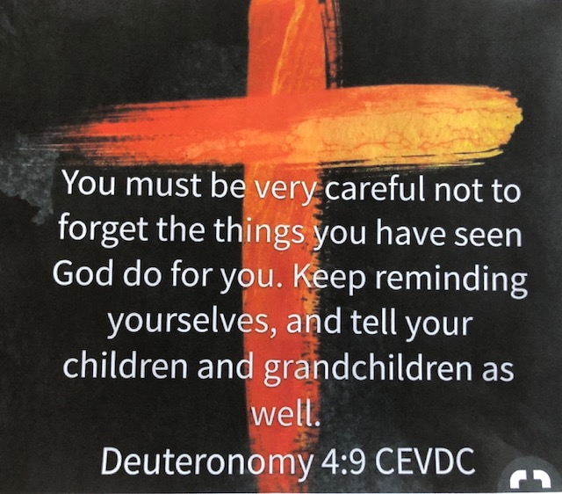

Slide 38
Be Healed In Jesus Name
Dodie Osteen
Video
https://www.youtube.com/watch?v=52IaLDgiz0I

Slide 39
Meet The Mom Whose Son Survived Falling Through The Ice
Video
https://www.youtube.com/watch?v=Q4HG4vNw8VQ

Slide 40
Sharing Personal Testimonies

Slide 41
Saturday Afternoon Praise Music
I Have A Maker:
https://www.youtube.com/watch?v=cHkC4urVp6A
There Is Power In The Name Of Jesus:
https://www.youtube.com/watch?v=pkR33OsvJSs

Slide 42
Road Blocks To Healing
Spiritual – Emotional – Physical

Slide 43
Road Blocks To Healing
We Are Still In Bondage
We Don’t Believe In Healing
We Are Rebellious
We Are Disobedient
We Still Continue To Sin
We Have An Unforgiving Spirit
  We Are Not Willing To Take Action
  We Don’t Want To Be Healed
  We Feel Unworthy
  We Need To Study It Out In Our Minds First And Then Ask God
  We Put God In A Box And Expect The Answer Our Way

Slide 44
Road Blocks To Healing (Cont’d)
Not Praying Specifically
Praying For Symptoms, And Not The Root Problem
We Don’t Have The Desire To Exercise Our Faith
We Have A Lack Of Knowledge Of The Word
We Feel Guilty And Are Ashamed For A Sin We Or Others Committed
We Lack The Discipline Needed To Complete The Healing Process, Only Go Half Way
We Still Are Looking At Our Bodies As Objects Of A Physical Or Mental Defect And Are Not Trusting God
We Have Doubt, Fear, And Anxiety
Generational Curses May Be Involved (Ex. 20:6, Num. 4:18, Deut. 5:9)

Slide 45
When Some People Don’t Get Healed?
People Rationalize And/Or Make Judgments: (Rom.14:10-13) (Matt. 7:1-3)
Not God’s Timing, Plan, Or Will For You.
Not Believing, Not Exercising Our Faith, Not Repentant, Not Obedient, Or Not Putting God First.
Have Sin(s) In Their Lives And Are At Enmity With God. (James 4:4)
We Ask For Healing But We Ask Amiss. (James 4:1-3)
Too Many Roadblocks And We Are Not Ready To Surrender To God’s Will.

Slide 46
When Some People Don’t Get Healed?
People Rationalize And/Or Make Judgments:
(Rom.14:10-13) (Matt. 7:1-3)
6. The Person Doesn’t Understand Scriptures And What They Mean Regarding God’s Will And Healing. Our Minds Need To Be Renewed. (Rom. 12:2)
7. The Person Doing The Healing Prayer May Not Be Knowledgeable About The Person’s Needs Or Situation. Didn’t Prepare Or Ask Questions First.
8. May Need A Deliverance Before Healing Can Take Place.
9. Sickness And Disease Belong To The Enemy. He Doesn’t Want You Well. (John 10:10)

Slide 47
When Some People Don’t Get Healed?
The Bottom Line Answer:
We Don’t Know Why, We Don’t Have The Answer, Only
God Knows Why!

Slide 48
Emotional Healing

Slide 49
“Getting Real”
On The Outside
On The Inside
Shame
Guilt
Fear
Anxiety
Doubt
Anger
Sexual Abuse
Vows
Lust
Addiction
Rebellion
I’m Fine, I’m Great, I’m Ok, Really I am
Depression

Slide 50
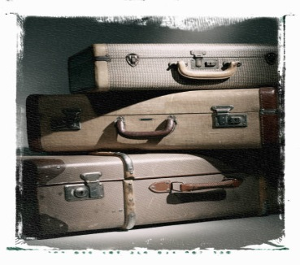
Sin Causes Emotional Sickness
Love Of Money
Jealousy
Pride
Materialism
Impatience
Lust
Criticizing
Food Addictions
Dishonesty
Unforgiveness
Co-dependence
Idolatry
Anger
Pornography
Procrastination
New Age
Fornication
Occultism
Adultery
Physical Abuse
Emotional Abuse
Sexual Abuse
Wrong Friendships
Sin Of Omission
We Must Get Rid Of The Sin, Woundedness,
Pain, And Excess Baggage In Our Lives To Be Emotionally Healed.

Slide 51
Sin Causes Emotional Sickness (Cont’d)
Worry
Debt
Suppression
Rebellion
Greed
Bitterness
Anger
Hate
Jealousy
Resentment
Shame
Guilt
Excuses
Unaccepting
Hopelessness
Betrayal
Ungrateful
Torment
Selfishness
Self-Indulgence
Blaming
Anxiety
Disobedience
Doubt
Denial
Frustration
Unpreparedness
Self-Worth
Time Management
Wrong Priorities
Complaining
Rejection
Finding Fault
Harboring
Fear

Slide 52
Forgiveness Is A Choice
And You Hold The Key
Surrender
Receive
Forgive
e
Release

Slide 53
Forgiveness
Hand Gestures
S F R R

Slide 54
Spirit Of Unforgiveness
Who Do You Need To Forgive
God
Jesus
Holy Spirit
OTHERS
YOURSELF

Slide 55
Prayer Of Forgiveness
Dear Jesus,
I Surrender Myself To You Lord And Choose To Forgive. Example: “(Mom)”, I Forgive You For: “Abandoning Me”, For: ______________. I Forgive You And Release You Now To Jesus. I Forgive Myself And Ask For Forgiveness For Harboring This Unforgiveness. Please Forgive Me. I Release Myself Now To You Lord And Receive Your Holy Spirit Who Is Filling Me Up, Healing Me, And Restoring Me.
In Jesus Name
Amen

Slide 56
Receiving The Gift Of Healing
Receiving A Gift From God.
Receiving The Fullness Of The Holy Spirit.
  Fruits Of The Spirit (Love, Joy, Peace, Patience, Kindness, Goodness, Faithfulness, Gentleness, And Self-Control …… Gal. 5:22-23)
  The Healing Experience And The Freedom

Slide 57
Spiritual Healing-
Renewing Your Spirit
(Ephesians 4:20-24)
Focus On God, Jesus, And The Holy Spirit.
Communicate And Be In Tune.
Study The Word To Know His Will.
Do Not Be Conformed To The World.
Become Spiritually Connected With God.
Exercise More Of Your Faith, Trust, And Obedience In God.
It Is All About ….
Relationship,
Relationship,
Relationship.

Slide 58

Spiritual Healing -
Renewing Your Mind
(Romans 12:2)
Put The Word In Your Heart.
Daily Walking And Talking With The Lord.
Renewing Your Mind With Godly Things.
Be In Tune With The Holy Spirit.
Be Godly, Be Righteous, Be Holy.
Stay Focused On God’s Will For You.
Talk The Talk, And Walk The Walk.
Strive For Ongoing Spiritual Growth.

Slide 59
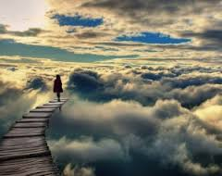
10 Steps For Your
Spiritual Walk
Make God’s Word The Final Authority In Your Life. (I Cor. 2:12, Rom. 4:20-22, Gal. 3:13)
Receive Your Healing By Faith In Prayer Before The Lord. (Date The Healing And Keep It Close By And Take Communion – Body For Healing And The Blood For The Forgiveness Of Sin)
Read Through All Of The Healing Scriptures Daily. (See OT And NT 31 Day List; Study Them And Memorize Them)
Continue In Your Daily Devotions And Bible Study; Reading, Learning, Growing, And Maturing. (Prov. 4:20-22) (Joshua 1:8)

Slide 60
10 Steps For Your
Spiritual Walk (Cont’d)
Speak Blessing Over Your Body And Speak In Line With The Word Of God Regarding Your Situation – Don’t Focus On The Problem Focus On The Healer.
Make Praise And Worship An Everyday Part Of Your Life. (I John 5:4) (I Cor.15:57)
Learn How To Use The Power And Authority That Has Been Given To You. (Luke 10:19, Isa. 54:17, Mark 11:23)
Take Time Each Day To Get Quiet And Listen To The Lord – Let Him Minister To You And Encourage You; He Is The Comforter. Learn To Listen To His Voice.

Slide 61
10 Steps For Your
Spiritual Walk (Cont’d)
  Check Your Spirit Before The Lord For Any Unforgiveness, Or Any Open Doors You May Have Left Open To The Enemy – Repent And Make Changes As Quickly As Possible. Sin Will Block The Blessing Of The Lord And Keep You In Darkness.
  (I John 1:9)
  10. Finally, Stand Firm And Keep On Standing Your Ground.
  (Eph. 6:10-18)

Slide 62
Spiritual Healing Scriptures
Psalm 27:4
Psalm 16:11
James 4:7
John 3:16-17
2 Cor. 5:17
I Peter 2:24
Col. 1:13
Psalm 34:15, 17
Psalm 46:1
Isa. 53:4-5
Psalm 107:20
Psalm 103:2-3
2 Cor. 4:16-17
Rom. 8:1-2, 10
Psalm 147:3
Proverbs 4:20-22
Ex. 23:25
Proverbs 3:7-8
Jer. 17:14
John 10:10
Isa. 58:8

Slide 63
Emotional Healing Scriptures
Matthew 6:14-15
Leviticus 6:6-7
Acts 10:43
Luke 6:36-38
Ephesians 4:32
Colossians 1:13-14
Ephesians 1:7
Colossians 2:13
Matthew 18:23-35
2 Sam 12:13
Psalm 51
Mark 3:28
Psalm 103:3
I John 1:9
Luke 15:11-24
(NIV)

Slide 64

Monthly Scriptures For Healing
31 Healing Scriptures In The Bible; One For
Every Day Of The Month:
Old Testament
Exod. 15:26 | Exod. 23:25-26 | Deut. 7:15 | Ps. 91:9-10 | Ps. 103:1-5 | Ps. 107:19-20 |Prov. 4:20-23 | Isa. 41:10 | Isa. 53:4-5 | Isa. 55:9-11 | Isa. 58:6-11 | Jer. 30:17 | Mal. 3:6 | Mal. 4:2-3
New Testament
Matt. 7:7-11 | Matt. 8:16-17 | Matt. 9:35 | Matt. 15:30-31 | Mark 11:22-24 | Mark 16:17-18 | Luke 4:17-19 | Luke 9:1-2 | Luke 10:8-9 | Luke 13:16 | Acts 4:29-30 Acts 5:15-16 | Acts 10:38 | Gal. 3:13 | James 5:13-16 | 1 John 5:14-15 | 3 John 2

Slide 65
Sharing Personal Testimonies

